Slide 1
INST 346 Spring 2025
Lecture 19
April 7, 2025
Professor Keith Marzullo

Slide 2
Network layer data plane: Learning objectives
Overview of network layer: data versus control plane
What’s inside a router
IP: the Internet Protocol
Generalized forwarding, SDN
Middleboxes

Slide 3
What’s inside a router

Slide 4
Router architecture overview
high-level view of generic router architecture:
routing, management
control plane (software)
operates in millisecond
time frame
routing
processor
forwarding data plane (hardware) operates in nanosecond timeframe
high-speed
switching
fabric
router input ports
router output ports

Slide 5


Input port functions: 1
lookup,
forwarding
queueing
line
termination
link
layer
protocol
(receive)
switch
fabric
physical layer:
bit-level reception
Datagram
decentralized switching:
using header field values, lookup output port using forwarding table in input port memory (“match plus action”)
goal: complete input port processing at ‘line speed’
input port queuing: if datagrams arrive faster than forwarding rate into switch fabric
link layer:
e.g., Ethernet
(chapter 6)
Frame
Notes:
Green box is a physical layer responsible for receiving bit level transmission. Copper, fiber wireless.
Link layer in blue – bit assemble into Ethernet frame. We will discuss this in details in chapter 6.
But most critical one, is here. Lookup, forwarding function. Lookup and forward is “Match plus action” behavior.
GOAL – processing at “line speed”, otherwise, buffer will be full and packet will be lost

Slide 6
Input port functions: 2
lookup,
forwarding
queueing
line
termination
link
layer
protocol
(receive)
switch
fabric
physical layer:
bit-level reception
decentralized switching:
using header field values, lookup output port using forwarding table in input port memory (“match plus action”)
destination-based forwarding: forward based only on destination IP address (traditional)
generalized forwarding: forward based on any set of header field values
link layer:
e.g., Ethernet
(chapter 6)

Slide 7
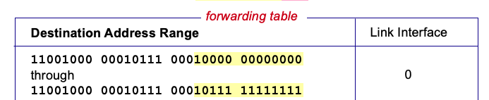
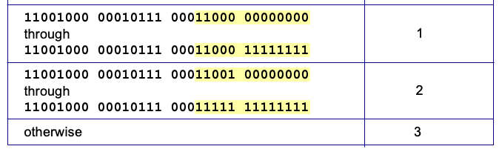
Destination-based forwarding: 1
200.23.16.0
through
200.23.23.255
200.23.24.0
through
200.23.24.255
200.23.25.0
through
200.23.25.255
Q: What happens if ranges don’t divide up so nicely?
Notes:
Text for this animation:
This all works out pretty nice and looks pretty simple!
But of course the devil is in the details, as the saying goes.
What happens, for example, when a subset of addresses say in this first range should go to say interface 3, rather than interface 0. Well, of course we could split the first address range into multiple pieces, and add in this new subrange with its new destination output port. But it turns out there’s a much simpler and elegant way to do this. Known as longest prefix matching.

Slide 8

Destination-based forwarding: 2
3
Notes:
Text for this animation:
This all works out pretty nice and looks pretty simple!
But of course the devil is in the details, as the saying goes.
What happens, for example, when a subset of addresses say in this first range should go to say interface 3, rather than interface 0. Well, of course we could split the first address range into multiple pieces, and add in this new subrange with its new destination output port. But it turns out there’s a much simpler and elegant way to do this. Known as longest prefix matching.

Slide 9
Longest prefix matching: 1
longest prefix match
when looking for the forwarding table entry for a given destination address, use longest address prefix that matches destination address.

Slide 10
Longest prefix matching: 2
longest prefix match
when looking for forwarding table entry for given destination address, use longest address prefix that matches destination address.
Destination Address Range
11001000 00010111 00010
11001000 00010111 00011000
11001000 00010111 00011
otherwise
Link interface
0
1
2
3
***
********
********
***
********

Slide 11
Longest prefix matching: 3
longest prefix match
when looking for forwarding table entry for given destination address, use longest address prefix that matches destination address.
Destination Address Range
11001000 00010111 00010
11001000 00010111 00011000
11001000 00010111 00011
otherwise
Link interface
0
1
2
3
***
********
********
***
********
examples:
11001000 00010111 00010110 10100001
which interface?
11001000 00010111 00011000 10101010
which interface?

Slide 12
Longest prefix matching: 4
longest prefix match
when looking for forwarding table entry for given destination address, use longest address prefix that matches destination address.
Destination Address Range
11001000 00010111 00010
11001000 00010111 00011000
11001000 00010111 00011
otherwise
Link interface
0
1
2
3
***
********
********
match!
***
********
examples:
11001000 00010111 00010110 10100001
which interface?
11001000 00010111 00011000 10101010
which interface?

Slide 13
Longest prefix matching: 5
longest prefix match
when looking for forwarding table entry for given destination address, use longest address prefix that matches destination address.
Destination Address Range
11001000 00010111 00010
11001000 00010111 00011000
11001000 00010111 00011
otherwise
Link interface
0
1
2
3
***
********
********
***
********
match!
examples:
11001000 00010111 00010110 10100001
which interface?
11001000 00010111 00011000 10101010
which interface?

Slide 14
Longest prefix matching: 6
longest prefix match
when looking for forwarding table entry for given destination address, use longest address prefix that matches destination address.
Destination Address Range
11001000 00010111 00010
11001000 00010111 00011000
11001000 00010111 00011
otherwise
Link interface
0
1
2
3
***
********
********
***
********
match!
examples:
11001000 00010111 00010110 10100001
which interface?
11001000 00010111 00011000 10101010
which interface?

Slide 15
Longest prefix matching: 7
we’ll see why longest prefix matching is used shortly, when we study addressing
longest prefix matching: often performed using ternary content addressable memories (TCAMs)
content addressable: present address to TCAM: retrieve address in one clock cycle, regardless of table size
Cisco Catalyst: ~1M routing table entries in TCAM

Slide 16
Switching fabrics: 1
transfer packet from input link to appropriate output link
switching rate: rate at which packets can be transfer from inputs to outputs
often measured as multiple of input/output line rate
N inputs: switching rate N times line rate desirable
R
(rate: NxR, ideally)
R
. . .
high-speed
switching
fabric
. . .
N input ports
N output ports
R
R

Slide 17
Switching fabrics: 2
transfer packet from input link to appropriate output link
switching rate: rate at which packets can be transfer from inputs to outputs
often measured as multiple of input/output line rate
N inputs: switching rate N times line rate desirable
three major types of switching fabrics:
memory
memory
bus
interconnection
network

Slide 18
Sidebar: Network Neutrality: 1
What is network neutrality?

Slide 19
Sidebar: Network Neutrality: 2
What is network neutrality?
technical: how an ISP should share/allocation its resources
packet scheduling, buffer management are the mechanisms

Slide 20
Sidebar: Network Neutrality: 3
What is network neutrality?
technical: how an ISP should share/allocation its resources
packet scheduling, buffer management are the mechanisms
social, economic principles
protecting free speech
encouraging innovation, competition

Slide 21
Sidebar: Network Neutrality: 4
What is network neutrality?
technical: how an ISP should share/allocation its resources
packet scheduling, buffer management are the mechanisms
social, economic principles
protecting free speech
encouraging innovation, competition
enforced legal rules and policies
Different countries have different “takes” on network neutrality

Slide 22
Sidebar: Network Neutrality: 5
2015 US FCC Order on Protecting and Promoting an Open Internet: three “clear, bright line” rules:

Slide 23
Sidebar: Network Neutrality: 6
2015 US FCC Order on Protecting and Promoting an Open Internet: three “clear, bright line” rules:
no blocking … “shall not block lawful content, applications, services, or non-harmful devices, subject to reasonable network management.”

Slide 24
Sidebar: Network Neutrality: 7
2015 US FCC Order on Protecting and Promoting an Open Internet: three “clear, bright line” rules:
no blocking … “shall not block lawful content, applications, services, or non-harmful devices, subject to reasonable network management.”
no throttling … “shall not impair or degrade lawful Internet traffic on the basis of Internet content, application, or service, or use of a non-harmful device, subject to reasonable network management.”

Slide 25
Sidebar: Network Neutrality: 8
2015 US FCC Order on Protecting and Promoting an Open Internet: three “clear, bright line” rules:
no blocking … “shall not block lawful content, applications, services, or non-harmful devices, subject to reasonable network management.”
no throttling … “shall not impair or degrade lawful Internet traffic on the basis of Internet content, application, or service, or use of a non-harmful device, subject to reasonable network management.”
no paid prioritization. … “shall not engage in paid prioritization”

Slide 26
ISP: telecommunications or information service? 1
Is an ISP a “telecommunications service” or an “information service” provider?
the answer really matters from a regulatory standpoint!

Slide 27
ISP: telecommunications or information service? 2
Is an ISP a “telecommunications service” or an “information service” provider?
the answer really matters from a regulatory standpoint!
US Telecommunication Act of 1934 and 1996:
Title II: imposes “common carrier duties” on telecommunications services: reasonable rates, non-discrimination and requires regulation
Title I: applies to information services:
no common carrier duties (not regulated)
but grants FCC authority “… as may be necessary in the execution of its functions”4

Slide 28
Network Layer: Internet: 1
host, router network layer functions:
transport layer: TCP, UDP
network
layer
link layer
physical layer

Slide 29
Network Layer: Internet: 2
host, router network layer functions:
transport layer: TCP, UDP
Path-selection algorithms: implemented in
routing protocols (OSPF, BGP)
SDN controller
network
layer
forwarding
table
link layer
physical layer

Slide 30
Network Layer: Internet: 3
host, router network layer functions:
transport layer: TCP, UDP
IP protocol
datagram format
addressing
packet handling conventions
Path-selection algorithms: implemented in
routing protocols (OSPF, BGP)
SDN controller
network
layer
forwarding
table
link layer
physical layer

Slide 31
Network Layer: Internet: 4
host, router network layer functions:
transport layer: TCP, UDP
IP protocol
datagram format
addressing
packet handling conventions
Path-selection algorithms: implemented in
routing protocols (OSPF, BGP)
SDN controller
network
layer
forwarding
table
ICMP protocol
error reporting
router “signaling”
link layer
physical layer

Slide 32
IP Datagram format: 1
32 bits
IP protocol version number
head.
len
type of
service
total datagram
length (bytes)
ver
length
header length(bytes)
flgs
fragment
offset
16-bit identifier
time to
live
upper
layer
header
checksum
source IP address
destination IP address
Maximum length: 64K bytes
Typically: 1500 bytes or less
32-bit destination IP address
options (if any)
payload data
(variable length,
typically a TCP
or UDP segment)

Slide 33
IP Datagram format: 2
32 bits
ver
head.
len
type of
service
length
“type” of service:
diffserv (0:5)
ECN (6:7)
flgs
fragment
offset
16-bit identifier
time to
live
upper
layer
header
checksum
TTL: remaining max hops
(decremented at each router)
source IP address
destination IP address
upper layer protocol (e.g., TCP or UDP)
options (if any)
payload data
(variable length,
typically a TCP
or UDP segment)

Slide 34
IP Datagram format: 3
32 bits
ver
head.
len
type of
service
length
flgs
fragment
offset
fragmentation/
reassembly
16-bit identifier
time to
live
upper
layer
header
checksum
header checksum
source IP address
destination IP address
options (if any)
payload data
(variable length,
typically a TCP
or UDP segment)

Slide 35
IP Datagram format: 4
32 bits
ver
head.
len
type of
service
length
flgs
fragment
offset
16-bit identifier
time to
live
upper
layer
header
checksum
source IP address
32-bit source IP address
destination IP address
32-bit destination IP address
overhead
options (if any)
e.g., timestamp, record route taken
20 bytes of TCP
20 bytes of IP
= 40 bytes + app layer overhead for TCP+IP
payload data
(variable length,
typically a TCP
or UDP segment)

Slide 36

IP addressing: introduction 1
223.1.1.1
IP address: 32-bit identifier associated with each host or router interface
223.1.2.1
223.1.1.2
223.1.1.4
223.1.2.9
223.1.1.3
223.1.3.27
223.1.2.2
223.1.3.1
223.1.3.2

Slide 37
IP addressing: introduction 2
223.1.1.1
IP address: 32-bit identifier associated with each host or router interface
interface: connection between host/router and physical link
router’s typically have multiple interfaces
host typically has one or two interfaces (e.g., wired Ethernet, wireless 802.11)
223.1.2.1
223.1.1.2
223.1.1.4
223.1.2.9
223.1.1.3
223.1.3.27
223.1.2.2
223.1.3.1
223.1.3.2

Slide 38
IP addressing: introduction 3
223.1.1.1
IP address: 32-bit identifier associated with each host or router interface
interface: connection between host/router and physical link
routers typically have multiple interfaces
host typically has one or two interfaces (e.g., wired Ethernet, wireless 802.11)
223.1.2.1
223.1.1.2
223.1.1.4
223.1.2.9
223.1.1.3
223.1.3.27
223.1.2.2
223.1.3.1
223.1.3.2
dotted-decimal IP address notation:
223.1.1.1 = 11011111 00000001 00000001 00000001
223
1
1
1

Slide 39

IP addressing: introduction 4
223.1.1.1
Q: how are interfaces actually connected?
223.1.2.1
223.1.1.2
A: we’ll learn about that in chapters 6, 7
A: wired
Ethernet interfaces connected by Ethernet switches
223.1.1.4
223.1.2.9
223.1.1.3
223.1.3.27
223.1.2.2
223.1.3.1
223.1.3.2
For now: don’t need to worry about how one interface is connected to another (with no intervening router)
A: wireless WiFi interfaces connected by WiFi base station

Slide 40
Subnets: 1
223.1.1.1
What’s a subnet ?
device interfaces that can physically reach each other without passing through an intervening router
223.1.2.1
223.1.1.2
223.1.1.4
223.1.2.9
223.1.1.3
223.1.3.27
223.1.2.2
223.1.3.1
223.1.3.2
network consisting of 3 subnets

Slide 41
Subnets: 2
223.1.1.1
What’s a subnet ?
device interfaces that can physically reach each other without passing through an intervening router
223.1.2.1
223.1.1.2
223.1.1.4
223.1.2.9
223.1.1.3
223.1.3.27
223.1.2.2
IP addresses have structure:
subnet part: devices in same subnet have common high order bits
host part: remaining low order bits
223.1.3.1
223.1.3.2
network consisting of 3 subnets

Slide 42
Subnets: 3
223.1.1.1
Recipe for defining subnets:
detach each interface from its host or router, creating “islands” of isolated networks
223.1.2.1
223.1.1.2
223.1.1.4
223.1.2.9
223.1.1.3
223.1.3.27
223.1.2.2
223.1.3.1
223.1.3.2

Slide 43
Subnets: 4
223.1.1.1
Recipe for defining subnets:
detach each interface from its host or router, creating “islands” of isolated networks
223.1.2.1
223.1.1.2
223.1.1.4
223.1.2.9
223.1.1.3
223.1.3.27
223.1.2.2
223.1.3.1
223.1.3.2

Slide 44
Subnets: 5
223.1.1.1
Recipe for defining subnets:
detach each interface from its host or router, creating “islands” of isolated networks
each isolated network is called a subnet
223.1.2.1
223.1.1.2
223.1.1.4
223.1.2.9
223.1.1.3
223.1.3.27
223.1.2.2
223.1.3.1
223.1.3.2

Slide 45
Subnets: 6
subnet 223.1.1.0/24
223.1.1.1
subnet 223.1.2.0/24
Recipe for defining subnets:
detach each interface from its host or router, creating “islands” of isolated networks
each isolated network is called a subnet
223.1.2.1
223.1.1.2
223.1.1.4
223.1.2.9
223.1.1.3
223.1.3.27
223.1.2.2
subnet
223.1.3.0/24
223.1.3.1
223.1.3.2
subnet mask: /24
(high-order 24 bits: subnet part of IP address)

Slide 46
Subnets: 7
223.1.1.2
where are the subnets?
what are the /24 subnet addresses?
223.1.1.1
223.1.1.4
223.1.1.3
223.1.9.2
223.1.7.0
223.1.9.1
223.1.7.1
223.1.8.1
223.1.8.0
223.1.2.6
223.1.3.27
223.1.2.1
223.1.2.2
223.1.3.1
223.1.3.2

Slide 47
Subnets: 8
223.1.1.2
where are the subnets?
what are the /24 subnet addresses?
223.1.1.1
223.1.1.4
223.1.1.3
223.1.9.2
223.1.7.0
223.1.9.1
223.1.7.1
223.1.8.1
223.1.8.0
223.1.2.6
223.1.3.27
223.1.2.1
223.1.2.2
223.1.3.1
223.1.3.2

Slide 48
Subnets: 9
223.1.1.2
subnet 223.1.1/24
where are the subnets?
what are the /24 subnet addresses?
223.1.1.1
223.1.1.4
223.1.1.3
223.1.9.2
223.1.7.0
subnet 223.1.7/24
subnet 223.1.9/24
223.1.9.1
223.1.7.1
223.1.8.1
223.1.8.0
subnet 223.1.2/24
223.1.2.6
subnet 223.1.8/24
223.1.3.27
subnet 223.1.3/24
223.1.2.1
223.1.2.2
223.1.3.1
223.1.3.2

Slide 49
IP addressing: CIDR
CIDR: Classless InterDomain Routing (pronounced “cider”)
subnet portion of address of arbitrary length
address format: a.b.c.d/x, where x is # bits in subnet portion of address
subnet
part
host
part
11001000 00010111 00010000 00000000
200.23.16.0/23

Slide 50
IP addresses: how to get one? 1
That’s actually two questions:
Q: How does a host get IP address within its network (host part of address)?
Q: How does a network get IP address for itself (network part of address)

Slide 51
IP addresses: how to get one? 2
That’s actually two questions:
Q: How does a host get IP address within its network (host part of address)?
Q: How does a network get IP address for itself (network part of address)
How does host get IP address?
hard-coded by sysadmin in config file (e.g., /etc/rc.config in UNIX)
DHCP: Dynamic Host Configuration Protocol: dynamically get address from as server
“plug-and-play”

Slide 52
DHCP: Dynamic Host Configuration Protocol 1
goal: host dynamically obtains IP address from network server when it “joins” network
can renew its lease on address in use
allows reuse of addresses (only hold address while connected/on)
support for mobile users who join/leave network

Slide 53
DHCP: Dynamic Host Configuration Protocol 2
goal: host dynamically obtains IP address from network server when it “joins” network
can renew its lease on address in use
allows reuse of addresses (only hold address while connected/on)
support for mobile users who join/leave network
DHCP overview:
host broadcasts DHCP discover msg [optional]
DHCP server responds with DHCP offer msg [optional]
host requests IP address: DHCP request msg
DHCP server sends address: DHCP ack msg

Slide 54



DHCP client-server scenario: 1
Typically, DHCP server will be co-located in router, serving all subnets to which router is attached
DHCP server
223.1.1.1
223.1.2.1
223.1.2.5
223.1.1.2
223.1.1.4
223.1.2.9
223.1.1.3
223.1.3.27
arriving DHCP client needs
address in this network
223.1.2.2
223.1.3.1
223.1.3.2

Slide 55


DHCP client-server scenario: 2
DHCP server: 223.1.2.5
Arriving client
Broadcast: is there a DHCP server out there?

Slide 56
DHCP client-server scenario: 3
DHCP server: 223.1.2.5
DHCP discover
Arriving client
src : 0.0.0.0, 68
dest.: 255.255.255.255,67
yiaddr: 0.0.0.0
transaction ID: 654

Slide 57
DHCP client-server scenario: 4
DHCP server: 223.1.2.5
DHCP discover
Arriving client
src : 0.0.0.0, 68
dest.: 255.255.255.255,67
yiaddr: 0.0.0.0
transaction ID: 654
DHCP offer
Broadcast: I’m a DHCP server! Here’s an IP address you can use

Slide 58
DHCP client-server scenario: 5
DHCP server: 223.1.2.5
DHCP discover
Arriving client
src : 0.0.0.0, 68
dest.: 255.255.255.255,67
yiaddr: 0.0.0.0
transaction ID: 654
DHCP offer
src: 223.1.2.5, 67
dest: 255.255.255.255, 68
yiaddr: 223.1.2.4
transaction ID: 654
lifetime: 3600 secs

Slide 59
DHCP client-server scenario: 6
DHCP server: 223.1.2.5
DHCP discover
Arriving client
src : 0.0.0.0, 68
dest.: 255.255.255.255,67
yiaddr: 0.0.0.0
transaction ID: 654
DHCP offer
src: 223.1.2.5, 67
dest: 255.255.255.255, 68
yiaddr: 223.1.2.4
transaction ID: 654
lifetime: 3600 secs
The two steps above can be skipped “if a client remembers and wishes to reuse a previously allocated network address” [RFC 2131]

Slide 60
DHCP client-server scenario: 7
DHCP server: 223.1.2.5
DHCP discover
Arriving client
src : 0.0.0.0, 68
dest.: 255.255.255.255,67
yiaddr: 0.0.0.0
transaction ID: 654
DHCP offer
src: 223.1.2.5, 67
dest: 255.255.255.255, 68
yiaddr: 223.1.2.4
transaction ID: 654
lifetime: 3600 secs
The two steps above can be skipped “if a client remembers and wishes to reuse a previously allocated network address” [RFC 2131]
DHCP request
Broadcast: OK. I would like to use this IP address!

Slide 61
DHCP client-server scenario: 8
DHCP server: 223.1.2.5
DHCP discover
Arriving client
src : 0.0.0.0, 68
dest.: 255.255.255.255,67
yiaddr: 0.0.0.0
transaction ID: 654
DHCP offer
src: 223.1.2.5, 67
dest: 255.255.255.255, 68
yiaddr: 223.1.2.4
transaction ID: 654
lifetime: 3600 secs
The two steps above can be skipped “if a client remembers and wishes to reuse a previously allocated network address” [RFC 2131]
DHCP request
src: 0.0.0.0, 68
dest:: 255.255.255.255, 67
yiaddr: 223.1.2.4
transaction ID: 655
lifetime: 3600 secs

Slide 62
DHCP client-server scenario: 9
DHCP server: 223.1.2.5
DHCP discover
Arriving client
src : 0.0.0.0, 68
dest.: 255.255.255.255,67
yiaddr: 0.0.0.0
transaction ID: 654
DHCP offer
src: 223.1.2.5, 67
dest: 255.255.255.255, 68
yiaddr: 223.1.2.4
transaction ID: 654
lifetime: 3600 secs
The two steps above can be skipped “if a client remembers and wishes to reuse a previously allocated network address” [RFC 2131]
DHCP request
src: 0.0.0.0, 68
dest:: 255.255.255.255, 67
yiaddr: 223.1.2.4
transaction ID: 655
lifetime: 3600 secs
DHCP ACK
src: 223.1.2.5, 67
dest: 255.255.255.255, 68
yiaddr: 223.1.2.4
transaction ID: 655
lifetime: 3600 secs
Broadcast: OK. You’ve got that IP address!

Slide 63
DHCP client-server scenario: 10
DHCP server: 223.1.2.5
DHCP discover
Arriving client
src : 0.0.0.0, 68
dest.: 255.255.255.255,67
yiaddr: 0.0.0.0
transaction ID: 654
DHCP offer
src: 223.1.2.5, 67
dest: 255.255.255.255, 68
yiaddr: 223.1.2.4
transaction ID: 654
lifetime: 3600 secs
The two steps above can be skipped “if a client remembers and wishes to reuse a previously allocated network address” [RFC 2131]
DHCP request
src: 0.0.0.0, 68
dest:: 255.255.255.255, 67
yiaddr: 223.1.2.4
transaction ID: 655
lifetime: 3600 secs
DHCP ACK
src: 223.1.2.5, 67
dest: 255.255.255.255, 68
yiaddr: 223.1.2.4
transaction ID: 655
lifetime: 3600 secs

Slide 64
DHCP: more than IP addresses
DHCP can return more than just allocated IP address on subnet:
address of first-hop router for client (“default gateway”)
name and IP address of DNS sever
network mask (indicating network versus host portion of address)

Slide 65


DHCP: example 1
Connecting laptop will use DHCP to get IP address, address of first-hop router, address of DNS server.
168.1.1.1
router with DHCP
server built into
router

Slide 66
DHCP: example 2
DHCP
DHCP
UDP
IP
Eth
Phy
Connecting laptop will use DHCP to get IP address, address of first-hop router, address of DNS server.
DHCP
DHCP
DHCP
DHCP
DHCP REQUEST message encapsulated in UDP, encapsulated in IP, encapsulated in Ethernet
168.1.1.1
router with DHCP
server built into
router

Slide 67
DHCP: example 3
Connecting laptop will use DHCP to get IP address, address of first-hop router, address of DNS server.
DHCP REQUEST message encapsulated in UDP, encapsulated in IP, encapsulated in Ethernet
DHCP
168.1.1.1
Ethernet frame broadcast (dest: FFFFFFFFFFFF) on LAN, received at router running DHCP server
router with DHCP
server built into
router

Slide 68
DHCP: example 4
Connecting laptop will use DHCP to get IP address, address of first-hop router, address of DNS server.
DHCP REQUEST message encapsulated in UDP, encapsulated in IP, encapsulated in Ethernet
DHCP
DHCP
UDP
IP
Eth
Phy
168.1.1.1
DHCP
DHCP
DHCP
Ethernet frame broadcast (dest: FFFFFFFFFFFF) on LAN, received at router running DHCP server
DHCP
router with DHCP
server built into
router
DHCP
Ethernet de-mux’ed to IP de-mux’ed, UDP de-mux’ed to DHCP

Slide 69
DHCP: example 5
DCP server formulates DHCP ACK containing client’s IP address, IP address of first-hop router for client, name & IP address of DNS server
DHCP
DHCP
UDP
IP
Eth
Phy
router with DHCP
server built into
router

Slide 70
DHCP: example 6
DHCP
UDP
IP
Eth
Phy
DCP server formulates DHCP ACK containing client’s IP address, IP address of first-hop router for client, name & IP address of DNS server
DHCP
DHCP
DHCP
DHCP
encapsulated DHCP server reply forwarded to client, de-muxing up to DHCP at client
DHCP
DHCP
UDP
IP
Eth
Phy
DHCP
DHCP
DHCP
router with DHCP
server built into
router
DHCP

Slide 71
DHCP: example 7
DCP server formulates DHCP ACK containing client’s IP address, IP address of first-hop router for client, name & IP address of DNS server
DHCP
encapsulated DHCP server reply forwarded to client, de-muxing up to DHCP at client
router with DHCP
server built into
router
client now knows its IP address, name and IP address of DNS server, IP address of its first-hop router

Slide 72
IP addresses: how to get one? 3
Q: how does network get subnet part of IP address?
A: gets allocated portion of its provider ISP’s address space
ISP's block 11001000 00010111 00010000 00000000 200.23.16.0/20

Slide 73
IP addresses: how to get one? 4
Q: how does network get subnet part of IP address?
A: gets allocated portion of its provider ISP’s address space
ISP's block 11001000 00010111 00010000 00000000 200.23.16.0/20
ISP can then allocate out its address space in (say) 8 blocks:
Organization 0 11001000 00010111 00010000 00000000 200.23.16.0/23
Organization 1 11001000 00010111 00010010 00000000 200.23.18.0/23
Organization 2 11001000 00010111 00010100 00000000 200.23.20.0/23
... ….. …. ….
Organization 7 11001000 00010111 00011110 00000000 200.23.30.0/23

Slide 74
IP addressing: last words ... 1
Q: how does an ISP get block of addresses?
A: ICANN: Internet Corporation for Assigned Names and Numbers http://www.icann.org/
allocates IP addresses, through 5 regional registries (RRs) (who may then allocate to local registries)
manages DNS root zone, including delegation of individual TLD (.com, .edu , …) management

Slide 75
IP addressing: last words ... 2
Q: how does an ISP get block of addresses?
A: ICANN: Internet Corporation for Assigned Names and Numbers http://www.icann.org/
allocates IP addresses, through 5 regional registries (RRs) (who may then allocate to local registries)
manages DNS root zone, including delegation of individual TLD (.com, .edu , …) management
Q: are there enough 32-bit IP addresses?
ICANN allocated last chunk of IPv4 addresses to RRs in 2011
NAT (next) helps IPv4 address space exhaustion
IPv6 has 128-bit address space

Slide 76

IP addressing: last words ... 3
Q: how does an ISP get block of addresses?
A: ICANN: Internet Corporation for Assigned Names and Numbers http://www.icann.org/
allocates IP addresses, through 5 regional registries (RRs) (who may then allocate to local registries)
manages DNS root zone, including delegation of individual TLD (.com, .edu , …) management
Q: are there enough 32-bit IP addresses?
ICANN allocated last chunk of IPv4 addresses to RRs in 2011
NAT (next) helps IPv4 address space exhaustion
IPv6 has 128-bit address space
"Who the hell knew how much address space we needed?" Vint Cerf (reflecting on decision to make IPv4 address 32 bits long)

Slide 77
NAT: network address translation 1
NAT: all devices in local network share just one IPv4 address as far as outside world is concerned
rest of
Internet
local network (e.g., home network) 10.0.0/24
10.0.0.1
138.76.29.7
10.0.0.4
10.0.0.2
10.0.0.3
all datagrams leaving local network have same source NAT IP address: 138.76.29.7, but different source port numbers
datagrams with source or destination in this network have 10.0.0/24 address for source, destination (as usual)

Slide 78
NAT: network address translation 2
all devices in local network have 32-bit addresses in a “private” IP address space (10/8, 172.16/12, 192.168/16 prefixes) that can only be used in local network
advantages:
just one IP address needed from provider ISP for all devices
can change addresses of host in local network without notifying outside world
can change ISP without changing addresses of devices in local network
security: devices inside local net not directly addressable, visible by outside world

Slide 79
NAT: network address translation 3
implementation: NAT router must (transparently):
outgoing datagrams: replace (source IP address, port #) of every outgoing datagram to (NAT IP address, new port #)
remote clients/servers will respond using (NAT IP address, new port #) as destination address
remember (in NAT translation table) every (source IP address, port #) to (NAT IP address, new port #) translation pair
incoming datagrams: replace (NAT IP address, new port #) in destination fields of every incoming datagram with corresponding (source IP address, port #) stored in NAT table

Slide 80
NAT: network address translation 4
NAT translation table
WAN side addr LAN side addr
1: host 10.0.0.1 sends datagram to 128.119.40.186, 80
S: 10.0.0.1, 3345
D: 128.119.40.186, 80
10.0.0.1
1
10.0.0.4
10.0.0.2
138.76.29.7
10.0.0.3

Slide 81
NAT: network address translation 5
NAT translation table
WAN side addr LAN side addr
2: NAT router changes datagram source address from 10.0.0.1, 3345 to 138.76.29.7, 5001,
updates table
138.76.29.7, 5001 10.0.0.1, 3345
…… ……
S: 10.0.0.1, 3345
D: 128.119.40.186, 80
10.0.0.1
1
2
S: 138.76.29.7, 5001
D: 128.119.40.186, 80
10.0.0.4
10.0.0.2
138.76.29.7
10.0.0.3

Slide 82
NAT: network address translation6
NAT translation table
WAN side addr LAN side addr
138.76.29.7, 5001 10.0.0.1, 3345
…… ……
S: 10.0.0.1, 3345
D: 128.119.40.186, 80
10.0.0.1
1
2
S: 138.76.29.7, 5001
D: 128.119.40.186, 80
10.0.0.4
10.0.0.2
138.76.29.7
S: 128.119.40.186, 80
D: 10.0.0.1, 3345
4
S: 128.119.40.186, 80
D: 138.76.29.7, 5001
3
10.0.0.3
3: reply arrives, destination address: 138.76.29.7, 5001

Slide 83
NAT: network address translation 7
NAT has been controversial:
routers “should” only process up to layer 3
address “shortage” should be solved by IPv6
violates end-to-end argument (port # manipulation by network-layer device)
NAT traversal: what if client wants to connect to server behind NAT?
but NAT is here to stay:
extensively used in home and institutional nets, 4G/5G cellular nets

Slide 84
IPv6: motivation
initial motivation: 32-bit IPv4 address space would be completely allocated
additional motivation:
speed processing/forwarding: 40-byte fixed length header
enable different network-layer treatment of “flows”

Slide 85
IPv6 datagram format
flow label: identify datagrams in same "flow.” (concept of “flow” not well defined).
32 bits
priority: identify priority among datagrams in flow
ver
pri
flow label
payload len
next hdr
hop limit
source address
(128 bits)
128-bit
IPv6 addresses
destination address
(128 bits)
payload (data)
What’s missing (compared with IPv4):
no checksum (to speed processing at routers)
no fragmentation/reassembly
no options (available as upper-layer, next-header protocol at router)

Slide 86
Transition from IPv4 to IPv6
not all routers can be upgraded simultaneously
no “flag days”
how will network operate with mixed IPv4 and IPv6 routers?
tunneling: IPv6 datagram carried as payload in IPv4 datagram among IPv4 routers (“packet within a packet”)
tunneling used extensively in other contexts (4G/5G)
IPv4 header fields
IPv6 header fields
IPv4 payload
IPv4 source, dest addr
IPv6 source dest addr
UDP/TCP payload
IPv6 datagram
IPv4 datagram

Slide 87
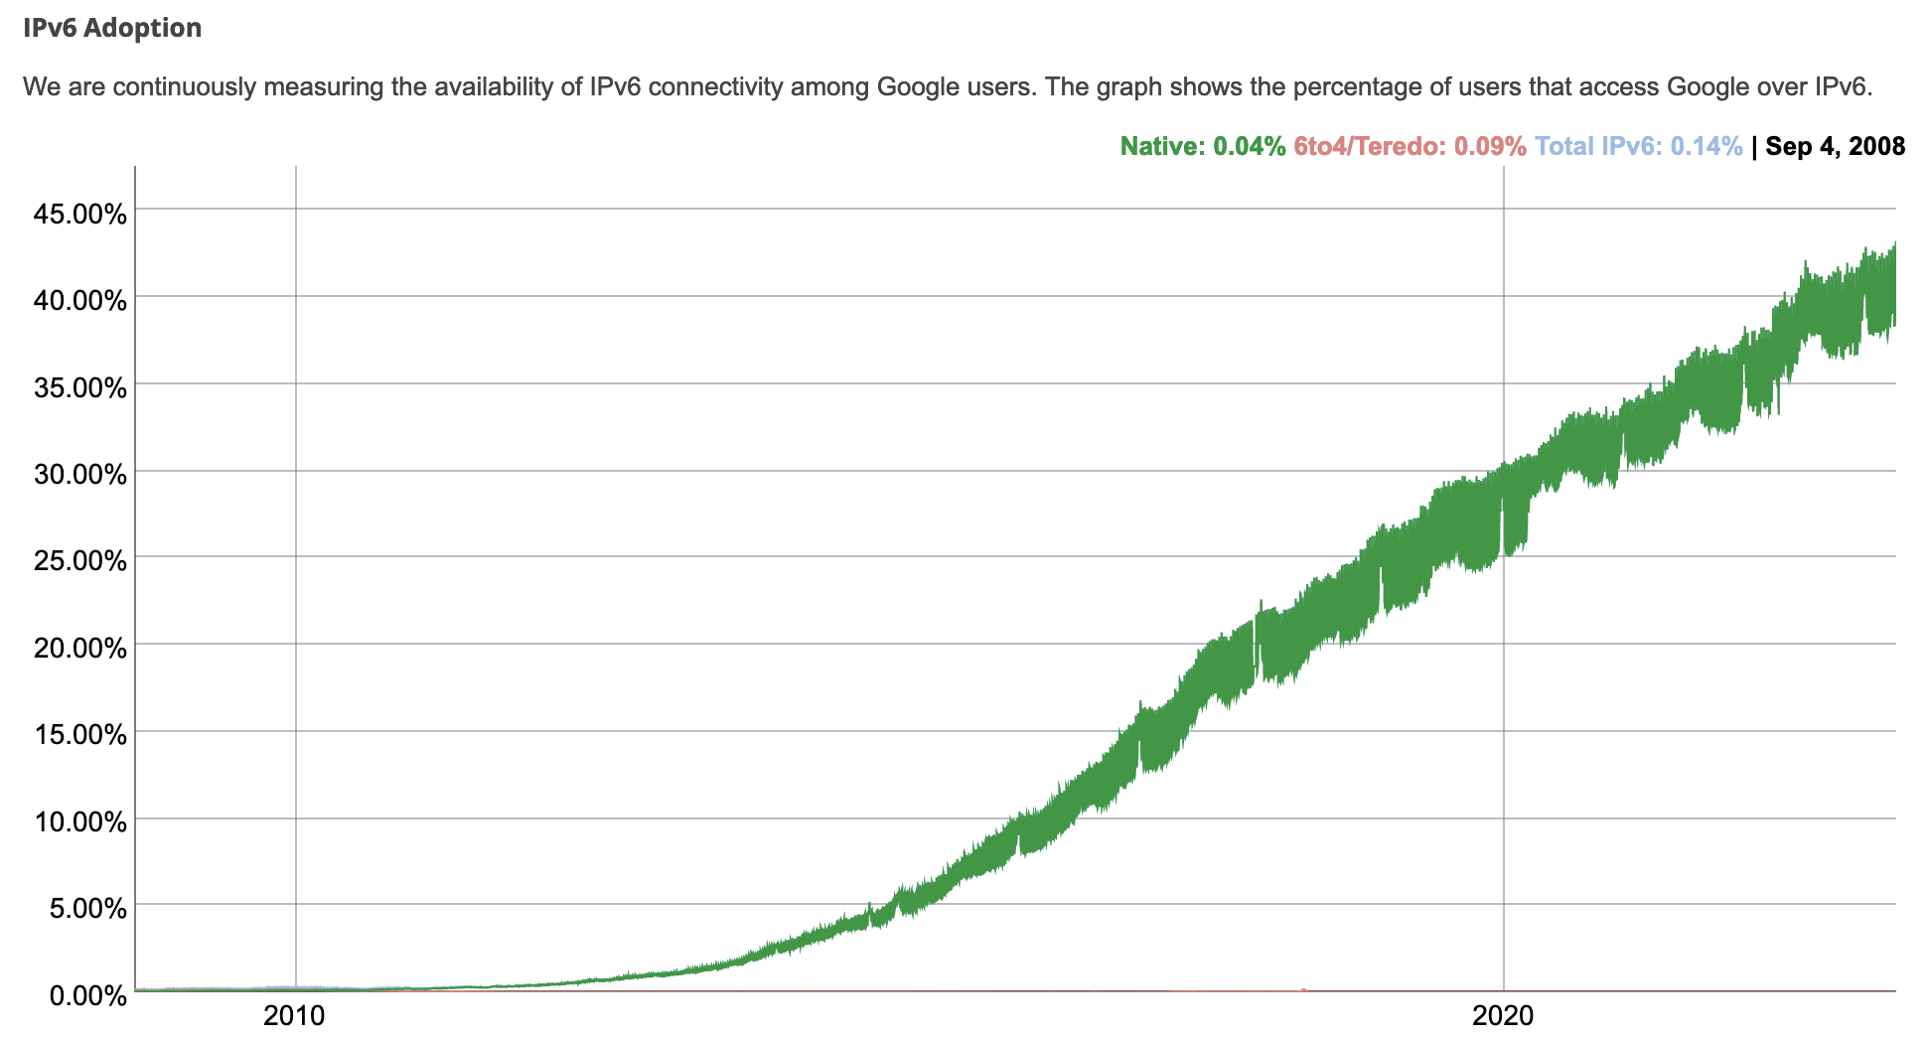
IPv6: adoption
Google¹: ~ 40% of clients access services via IPv6 (2023)
NIST: 1/3 of all US government domains are IPv6 capable

Slide 88
Middleboxes 1
Middlebox (RFC 3234)
“any intermediary box performing functions apart from normal, standard functions of an IP router on the data path between a source host and destination host”

Slide 89












Middleboxes everywhere!
Firewalls, IDS: corporate, institutional, service providers, ISPs
national or global ISP
NAT: home, cellular, institutional
Load balancers: corporate, service provider, data center, mobile nets
Application-specific: service providers, institutional, CDN
datacenter
network
Caches: service provider, mobile, CDNs
enterprise
network

Slide 90
Middleboxes 2
initially: proprietary (closed) hardware solutions
move towards “whitebox” hardware implementing open API
move away from proprietary hardware solutions
programmable local actions via match+action
move towards innovation/differentiation in software
SDN: (logically) centralized control and configuration management often in private/public cloud
network functions virtualization (NFV): programmable services over white box networking, computation, storage

Slide 91
The IP hourglass
HTTP
SMTP
RTP
…
Internet’s “thin waist”:
one network layer protocol: IP
must be implemented by every (billions) of Internet-connected devices
QUIC
DASH
many protocols in physical, link, transport, and application layers
TCP
UDP
IP
Ethernet
…
PPP
PDCP
WiFi
Bluetooth
copper radio fiber

Slide 92
The IP hourglass, at middle age
HTTP
SMTP
RTP
…
QUIC
DASH
Internet’s middle age “love handles”?
middleboxes, operating inside the network
TCP
UDP
caching
NAT
IP
NFV
Firewalls
Ethernet
…
PPP
PDCP
WiFi
Bluetooth
copper radio fiber

Slide 93
Architectural Principles of the Internet
RFC 1958
“Many members of the Internet community would argue that there is no architecture, but only a tradition, which was not written down for the first 25 years (or at least not by the IAB). However, in very general terms, the community believes that
the goal is connectivity, the tool is the Internet Protocol, and the intelligence is end to end rather than hidden in the network.”
Three cornerstone beliefs:
simple connectivity
IP protocol: that narrow waist
intelligence, complexity at network edge

Slide 94
The end-end argument: 1
some network functionality (e.g., reliable data transfer, congestion) can be implemented in network, or at network edge
application
transport
network
data link
physical
end-end implementation of reliable data transfer
application
transport
network
data link
physical
application
transport
network
data link
physical
application
transport
network
data link
physical
hop-by-hop (in-network) implementation of reliable data transfer
network
link
physical
network
link
physical
network
link
physical
network
link
physical
network
link
physical
network
link
physical

Slide 95
The end-end argument: 2
some network functionality (e.g., reliable data transfer, congestion) can be implemented in network, or at network edge
“The function in question can completely and correctly be implemented only with the knowledge and help of the application standing at the end points of the communication system. Therefore, providing that questioned function as a feature of the communication system itself is not possible. (Sometimes an incomplete version of the function provided by the communication system may be useful as a performance enhancement.)
We call this line of reasoning against low-level function implementation the “end-to-end argument.”
Saltzer, Reed, Clark 1981

Slide 96




Where’s the intelligence?
20th century phone net:
intelligence/computing at network switches
Internet (pre-2005)
intelligence, computing at edge
Internet (post-2005)
programmable network devices
intelligence, computing, massive application-level infrastructure at edge
Notes:
The 20th century phone network had dumb network endpoints, really by definition. The end points were rotary phones that maybe only your parents and grandparents remember; they weren’t computers. They really were dumb devices, and therefore the phone network had programmable switches that were quite smart. All functionality – well, all of the intelligence - was implemented within the network. It HAD to be. The end systems could not do anything more than send digits and send audio signals.
When the Internet came along, the endpoints and the switches were both programmable computers. So where to put the complexity? RFC 1958 – the architectural principles of the Internet RFC - that says “intelligence is end to end rather than hidden in the network.” That puts the intelligence clearly at the edge, like we see here. And that’s possible because the edge devices are smart; they’re programmable. Well that’s the diagram as I remember it 20 years ago.
And in the 20 years since, as we see the rise of middleboxes and SDN, we’re now seeing intelligence (in software) layered on top of “dumb” whiteboxes within the network. So I might add a brain here today. And with datacenters and content distribution networks, we see even smarter and more sophisticated application-level infrastructure being connected at points within the network. So now there are clearly much much bigger, much more computationally intensive and complex, endpoints if you will in today’s Internet

Slide 97
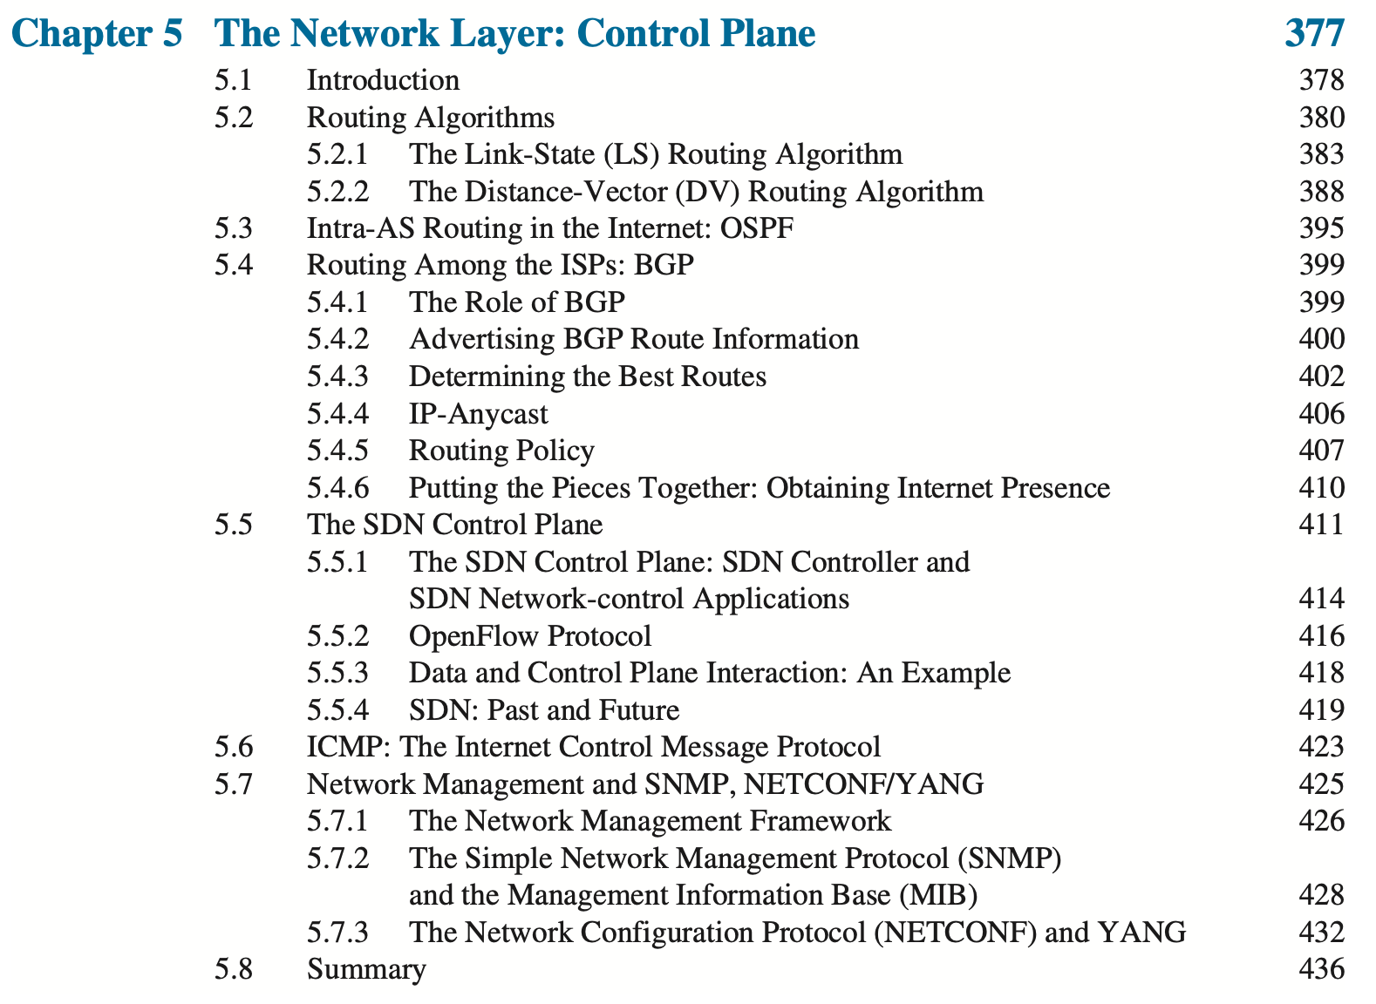

Next Week: The Network Layer: Control Plane
Computer Networking: A Top-Down Approach . 8th edition Jim Kurose, Keith Ross Pearson, 2020
Please read Sections 5.1, 5.3, and 5.4

